Slide 1
CREDIT CARD FRAUD DETECTION USING MACHINE LEARNING- Credit risk assessment and prediction in credit card applications.
TEAM-2
Yadika Dammagoni
Abhinav Keesari Apoorva Keesari

Slide 2
INTRODUCTION
In today's digital landscape, fraudulent activities in financial sectors like credit card applications pose significant challenges. This project aims to develop an advanced fraud detection system for credit card applications using machine learning techniques. By integrating two datasets—Application Data Set-1 and Previous Application Data Set-2—we aim to strengthen fraud detection mechanisms.
Our research focuses on identifying the most suitable machine learning model for detecting fraudulent credit card applications. We employ sophisticated algorithms and feature engineering techniques, including Exploratory Data Analysis (EDA), Recursive Feature Elimination (RFE), and the ADASYN method to address imbalanced datasets. Additionally, we use Synthetic Minority Over-sampling Technique (SMOTE) and cross-validation to enhance model accuracy.
Our study evaluates the impact of different preprocessing techniques on model accuracy, aiming to identify the most effective combinations. Through insights from relevant research papers and accuracy as the primary metric, we provide financial institutions with effective tools to combat fraud and safeguard against potential financial losses.

Slide 3
Research Problem & Novelty
In our research, we delve into the critical problem of identifying the most suitable machine learning model capable of optimally detecting fraudulent credit card applications. It centers on identifying the most optimal machine learning (ML) model capable of effectively assessing the creditworthiness of individuals within a banking system, with a focus on whether they are genuine applicants or potential fraudsters and their ability to repay loans if issued a credit card. To address this challenge, we conducted a thorough review of existing literature, where we identified specific shortcomings in some referenced papers. A notable observation was the omission of essential data preprocessing techniques by certain authors, leading to inaccurate results. Recognizing the pivotal role of features in model performance, we devised a comprehensive approach that integrates various preprocessing techniques. This includes Exploratory Data Analysis (EDA), Recursive Feature Elimination (RFE), as well as the ADASYN and SMOTE methods for handling imbalanced datasets. Our study meticulously evaluates the impact of different preprocessing techniques on model accuracy, with the ultimate goal of identifying the most effective combinations. By addressing these gaps in the existing literature and adopting a holistic approach to data preprocessing, our research contributes to the advancement of fraud detection systems in the financial sector.

Slide 4
FLOW CHART

Slide 5
Loaded both datasets automatically
Cleaned the both datasets
Performed EDA on both the datasets individually
Merged the both datasets
Performed RFE on the merged dataset
Split the dataset into train and test sets
Performed ADASYn to handle the imbalance and define classifiers with hyperparameters.
Trained the classifiers and measured the performance metrics of each classifier
Implemented cross-validation to evaluate the performance of multiple machine learning classifiers in detecting fraudulent credit card applications.
Implemented cross validation to train the classifiers iteratively with the balanced datasets and measured accuracies and compared the results of all the preprocessing combinations of techniques
Measured the performance metrics after implementing cross validation
Performed SMOTE to handle imbalance and trained nd tested the classifiers

Slide 6
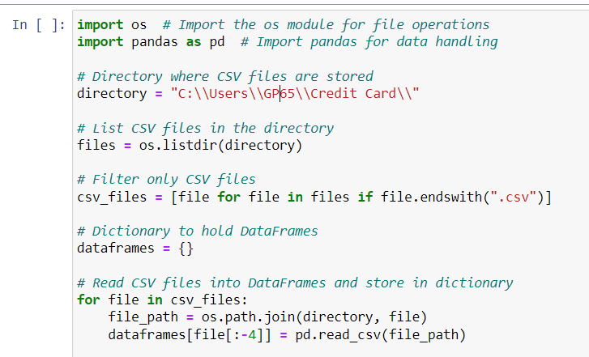
Dataset Selection & Loading
The provided code automates the process of loading datasets stored as CSV files from a specified directory.
By leveraging Python's OS module and the pandas library, the code dynamically lists all CSV files in the designated folder. It then proceeds to read each CSV file into a DataFrame and stores it in a dictionary, associating each DataFrame with its respective file name as the key.
This streamlined approach eliminates the need for manual intervention in loading datasets, enhancing efficiency and facilitating seamless data handling for subsequent analysis and processing tasks.

Slide 7
Data Cleaning
We are converting the values in several columns from the original unit of days to years. This conversion is performed using a custom function convert_to_years, which takes a number of days as input and returns the corresponding number of years by dividing the input value by 365 (the approximate number of days in a year) and taking the absolute value to handle negative values. Overall, this process standardizes the time units across these columns, making the data more interpretable and potentially facilitating analysis or modeling tasks.
We have also addressed the missing data in the DataFrame Application_data and Prev_data through a systematic process. Initially, we calculated the percentage of missing values for each column and identified those exceeding a threshold of 30%. Subsequently, sorted the columns based on their missing value percentages in descending order. Then, it created a new Data Frames by filtering out columns with less than 30% missing values, ensuring a more robust dataset.

Slide 8
Preprocessing Techniques
A preprocessing technique refers to a set of procedures or methods applied to raw data before it is used for analysis or modeling. These techniques are designed to prepare the data in a suitable format, address any inconsistencies or irregularities, and enhance its quality and usability for subsequent tasks such as machine learning or statistical analysis. Preprocessing may involve steps like data cleaning, normalization, feature scaling, feature engineering, handling missing values, and dealing with class imbalance, among others. The goal is to ensure that the data is well-suited for the specific analysis or modeling task at hand.
In our project we have used two preprocessing techniques and compared their results:-
1)Adasyn (Adaptive Synthetic Sampling)
2)Smote (Synthetic Minority Over-sampling Technique)

Slide 9
Exploratory Data Analysis

Slide 10
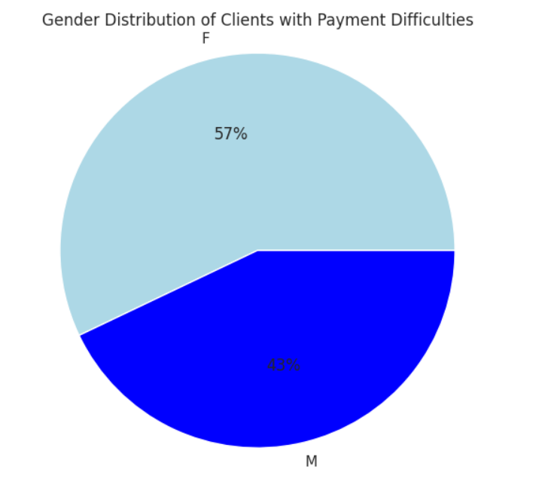
Gender Distribution of Clients With Payment Difficulties
'target 1' and 'target 0' are subsets of the datasets based on the values of a specific target variable. This target variable likely represents the outcome of interest in a predictive modeling task, such as whether a client experienced payment difficulties or not.
Target 1: This subset includes records where the target variable has a value of 1, indicating that the corresponding client experienced payment difficulties.
Target 0: This subset includes records where the target variable has a value of 0, indicating that the corresponding client did not experience payment difficulties
.

Slide 11
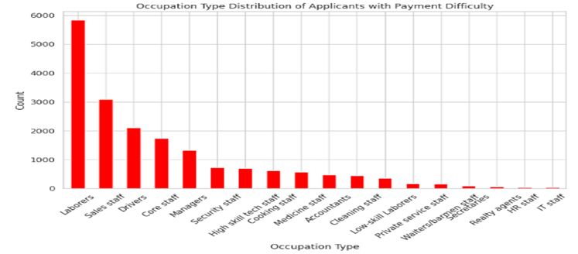
Occupation Type Distribution of Applicants with Payment Difficulty

Slide 12
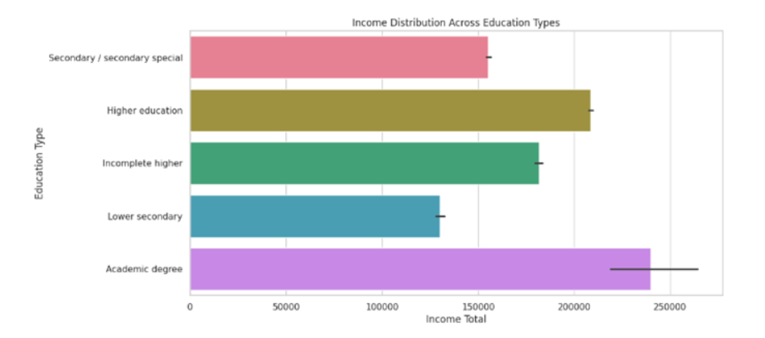
Income Distribution Across Education Types

Slide 13
Interpretation:
The plot provides insights into the income distribution across different education levels.
It suggests that individuals with higher education (such as bachelor’s or master’s degrees) tend to earn more than those with lower education levels. Incomplete higher, Lower secondary, and Academic degree have shorter bars, indicating lower total incomes for these groups.
In summary, this plot visually represents how income varies across different education types.

Slide 14
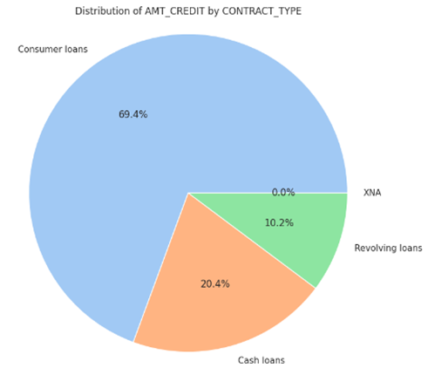
EDA - 3
By understanding the distribution of credit types, banks can assess their risk exposure.
Consumer loans, being the most significant segment, may carry higher risk due to their prevalence. Banks need to closely monitor these loans and evaluate the creditworthiness of borrowers.
Cash loans, while less common, still contribute significantly to the overall credit portfolio. Banks should analyze the risk associated with these loans as well.

Slide 15
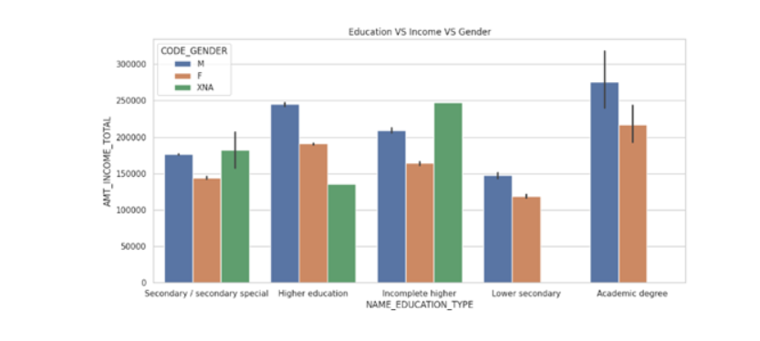
People with an academic degree tend to have higher incomes compared to other education types.
Among those with an academic degree:
Males earn notably more than females in the same category.

Slide 16
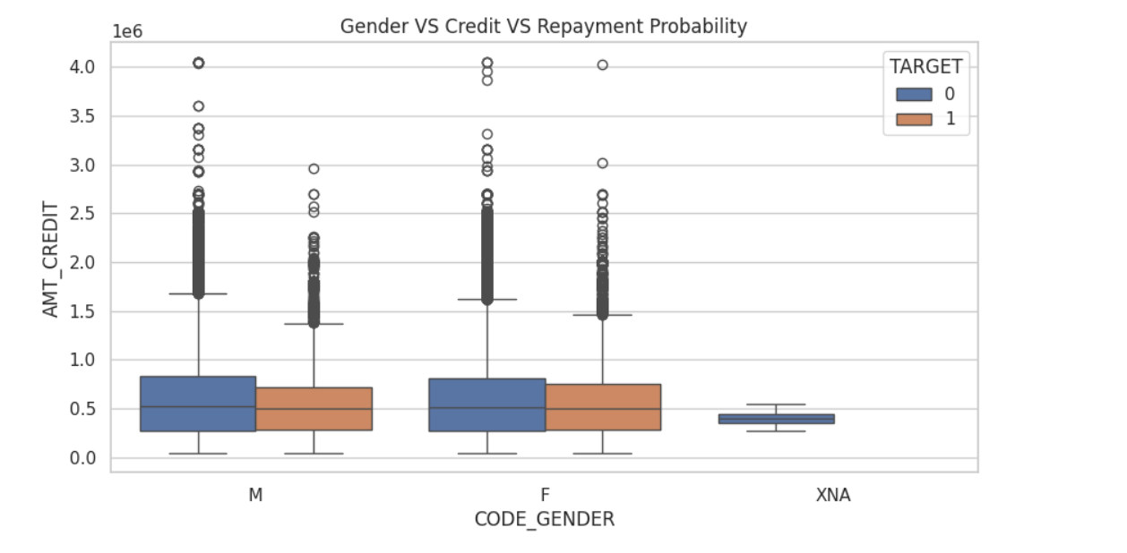
Each gender category has two sets of boxplots:
Blue: Represents individuals who probably will repay the loan (TARGET = 0).
Orange: Represents individuals who probably will not repay the loan (TARGET = 1).
The boxplots show the distribution of credit amounts within each gender category.
Outliers (individual points) may indicate extreme credit amounts.
In summary, this boxplot visually compares the credit amounts for different genders and their repayment probabilities.

Slide 17
Recursive Feature Elimination
RFE, or Recursive Feature Elimination, is a feature selection technique used in machine learning to identify the most relevant features for a predictive model. It works by recursively removing features from the dataset and assessing the model's performance after each removal. This process continues until the desired number of features is reached or until the model's performance no longer improves. RFE helps to improve model efficiency, reduce overfitting, and enhance interpretability by selecting the most informative features while discarding irrelevant or redundant ones.

Slide 18
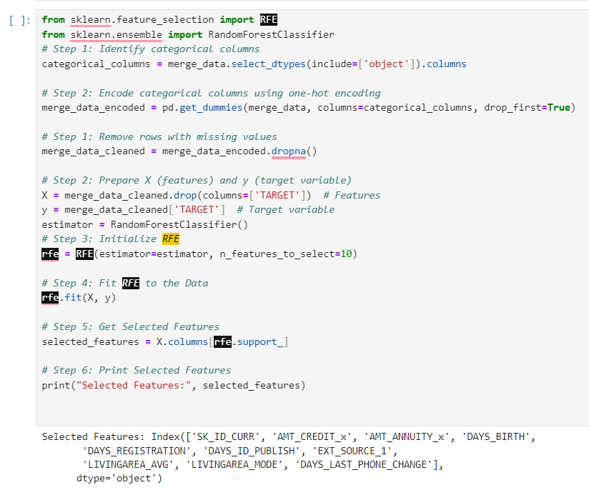
RFE CODE

Slide 19
Classifiers Used
Decision Tree Classifier
Random Forest Classifier
Logistic Regression
Artificial Neural Network
Naive Bayes Classifier

Slide 20
Performance metrics
1)Accuracy: It measures the proportion of correctly classified instances out of the total instances.
2)Precision: It measures the proportion of correctly predicted positive cases out of all predicted positive cases. It is also known as the positive predictive value.
3)Recall: It measures the proportion of correctly predicted positive cases out of all actual positive cases. It is also known as sensitivity or true positive rate.
4)F1-score: It is the harmonic mean of precision and recall. It provides a balance between precision and recall, especially in scenarios where there is an imbalance between the classes.
5)ROC-AUC: It represents the Area Under the Receiver Operating Characteristic (ROC) curve. It measures the model's ability to distinguish between the positive and negative classes across different thresholds.

Slide 21
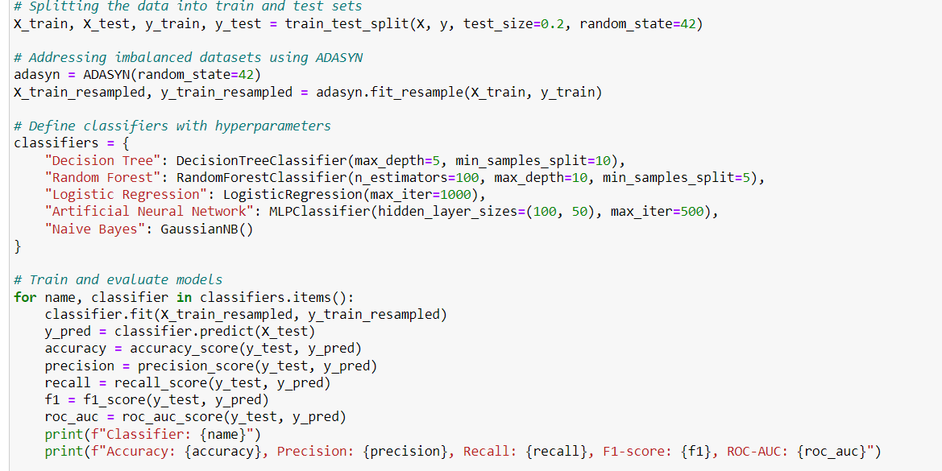
ADASYN

Slide 22
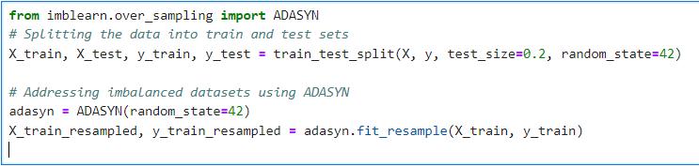
In this code segment, we are performing model training and evaluation for a binary classification task on imbalanced datasets. First, we split the dataset into training and testing sets using the train_test_split function from scikit-learn, with 20% of the data allocated for testing and using a fixed random state for reproducibility. Next, we address the imbalance in the training dataset using the Adaptive Synthetic Sampling (ADASYN) technique, which oversamples the minority class instances to balance the class distribution.

Slide 23
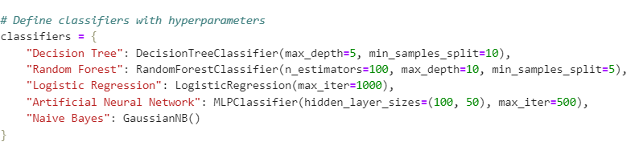
Then, we define a dictionary of classifiers, including Decision Tree, Random Forest, Logistic Regression, Artificial Neural Network, and Naive Bayes, each initialized with specific hyperparameters. Subsequently, we iterate over each classifier, fitting it to the resampled training data and evaluating its performance on the test set. For each classifier, we calculate and print metrics such as accuracy, precision, recall, F1-score, and ROC-AUC to assess its effectiveness in classifying instances of the positive class. This process enables comparison and selection of the most suitable classifier for the given classification task on imbalanced data.

Slide 24
Performance metrics after performing ADASYN

Slide 25

Performing cross validation on resampled data using ADASYN
In this code snippet, we're using a technique called cross-validation to assess how well our machine learning models perform. Here's how it works: we split our dataset into 5 equal parts, called folds. Then, we train our model on 4 of these folds and test it on the remaining one. We repeat this process 5 times, each time using a different fold as the test set.
For each model in our dictionary, we calculate the accuracy score for each fold using the cross_val_score function from scikit-learn. This gives us a list of accuracy scores, one for each fold. By taking the average of these scores using NumPy's np.mean function, we get an overall estimate of how accurate our model is across all the folds. We print out this average accuracy score for each model.
Using cross-validation gives us a more reliable idea of how well our models perform because it ensures that our evaluation isn't heavily influenced by a single training-testing split. Instead, we get a more comprehensive view of our model's performance across different subsets of the data.

Slide 26
Cross Validation results for Adasyn
The accuracy of random forest increased from 94% to 96% and the accuracy of Decision tree and Naive Bayes has increased well.

Slide 27
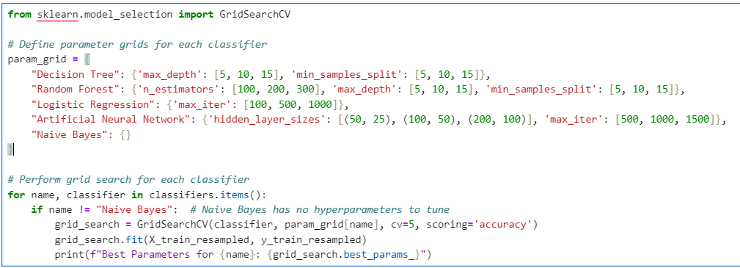
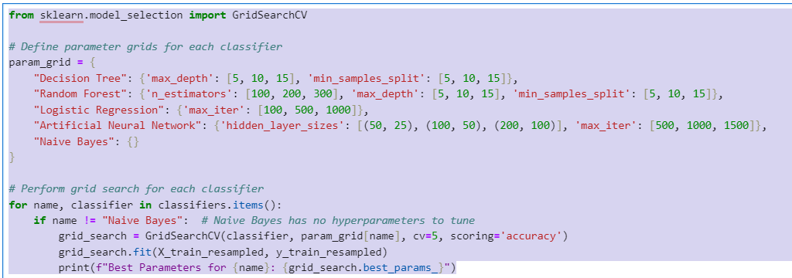
GRIDsearchCV

Slide 28
GridSearchCV results

Slide 29
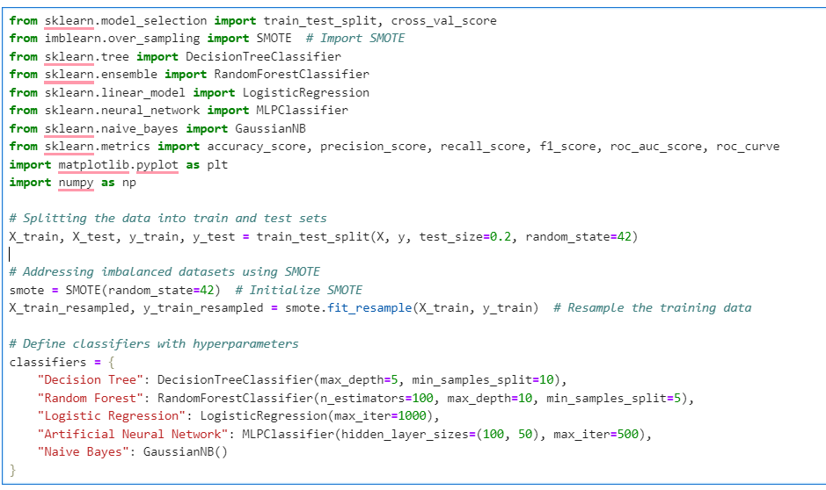
SMOTE

Slide 30
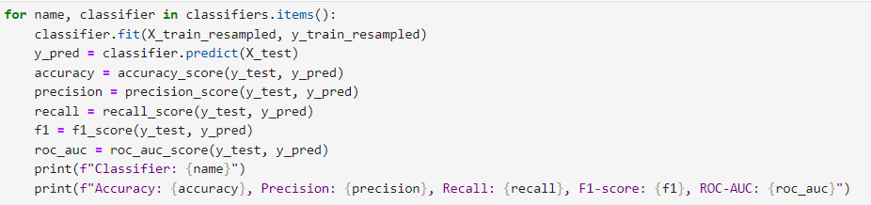
Results after applying Smote
v

Slide 31

Cross Validation results for Smote

Slide 32
Future Enhancements
Real-time Monitoring System: Building a real-time monitoring system that continuously analyzes incoming credit card applications for signs of fraud could be valuable for financial institutions. Integrating the developed model into such a system would enable timely detection and prevention of fraudulent activities.
Integration with Banking Systems: The research findings could be integrated into existing banking systems to provide automated fraud detection capabilities. This integration could involve building APIs or software modules that allow banks to seamlessly incorporate the predictive model into their application processing pipelines.
User Interface for Banks: Developing a user interface tailored for banking sector needs could facilitate the utilization of the predictive model. The interface could allow bank employees to input applicant information and receive instant predictions regarding the likelihood of fraudulence. This would streamline the decision-making process and enhance operational efficiency.

Slide 33
Related Work
[1]
Alam, T. M., Shaukat, K., Hameed, I. A., Luo, S., Sarwar, M. U., Shabbir, S., ... & Khushi, M. (2020). An investigation of credit card default prediction in the imbalanced datasets. Ieee Access, 8, 201173-201198.
[2]
W. Li, S. Ding, Y. Chen, H. Wang, and S. Yang, ‘‘Transfer learning-based default prediction model for consumer credit in China,’’J. Supercomput. vol. 75, no. 2, pp. 862–884, Feb. 2019
.
[3]
A. F. Atiya, “Bankruptcy prediction for credit risk using neural networks: A survey and new results,IEEE Trans. Neural Netw., vol.12, no. 4, pp. 929-935, Jul. 2001
A. Aditi, A. Dubey, A. Mathur and P. Garg, "Credit Card Fraud Detection Using Advanced Machine Learning Techniques," 2022 Fifth International Conference on Computational Intelligence and Communication Technologies (CCICT), Sonepat, India, 2022, pp. 56-60, doi: 10.1109/CCiCT56684.2022.00022. keywords: {Computational modeling;Programming;Credit cards;Fraud;Plastics;Regression tree analysis;Random forests;Credit card;Fraud;Decision Tree;Logistic Regression;Random Forest},
[4]

Slide 34
CONCLUSION
In conclusion, our research has successfully addressed the critical problem of identifying the most suitable machine learning model for detecting fraudulent credit card applications which is Random Forest with an accuracy of 97%.
Through a meticulous evaluation of the impact of different preprocessing techniques on model accuracy, we have identified the most effective combination.
Furthermore, by conducting comprehensive Exploratory Data Analysis (EDA) on both individual datasets and the merged dataset, we gained valuable insights into the behavior of the data and the impact of various features on model performance.
By examining the relationships between variables, such as correlations and distributions, we gained insights into which features had the most significant impact on the target variable that helped us in RFE and Hyper parameter tuning. Our study has not only contributed to filling gaps in existing literature by performing necessary preprocessing techniques but also paved the way for advancements in fraud detection systems within the financial sector. With a holistic approach to data preprocessing and model evaluation, we have achieved our initial objective of enhancing the accuracy and reliability of fraud detection models, ultimately providing financial institutions with more robust tools to combat fraudulent activities.

Slide 35
AKNOWLEGEMENT
We extend our heartfelt gratitude to Professor Dr. Ugur for his invaluable mentorship and unwavering support throughout this project. His expertise and guidance have been instrumental in shaping our research and enhancing our understanding of credit risk assessment.
We are equally thankful to Professor Dr. Johnson for his continuous support, insightful feedback, and introduction of Trello as a project management tool. His contributions have greatly streamlined our workflow and contributed to the project's success.
Furthermore, we express our appreciation to all the esteemed faculty members of the Computer Science department for their consistent support and encouragement. This project owes its success to the guidance and support of our esteemed mentors. We are sincerely grateful for their contributions and unwavering support throughout this endeavor.

Slide 36
THANKS!
Intrested to work more on this Project?
damma1y@cmich.edu

